Slide 1

Know the state of your home, everywhere you are!

Slide 2
Abstract:
When we started, we wanted to allow anyone to know the dynamics that happen in their own homes, so our goal was the realization of a system that allows the users to control the state of their house, with the simple use of a smartphone and a Telegram Bot.

Slide 3
Minimum Viable Product:
We decided that our MVP would be a small system that controls, with a sensor, the temperature and the humidity, and simulate the opening of a window with a cover, all in a box.
The difference from the other things that already exists is the possibility to know these two things by using a Telegram Bot.

Slide 4
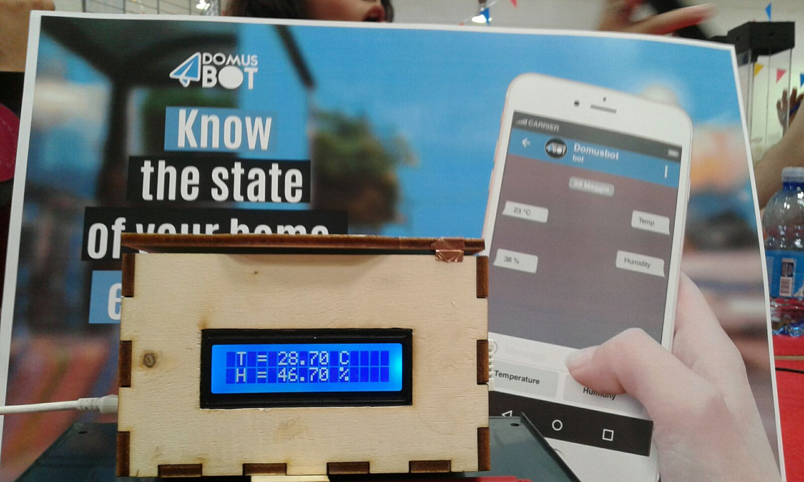

Slide 5
Already Done:
Functioning of the temperature and the humidity sensor.
Connecting the LCD screen and showing the data made by the sensor.
Opening and closing the cover, notified to the bot.
Made a Bot on Telegram (@DomusBot), which receives the data and interacts with the users.

Slide 6
For the Future:
Addition of other sensors (gas, light ecc.).
Possibility not only to know the state of your house, but also to control it with your smartphone (ex. opening and closing windows).
Implementation of security system like infrared sensors, webcams, cameras.

Slide 7
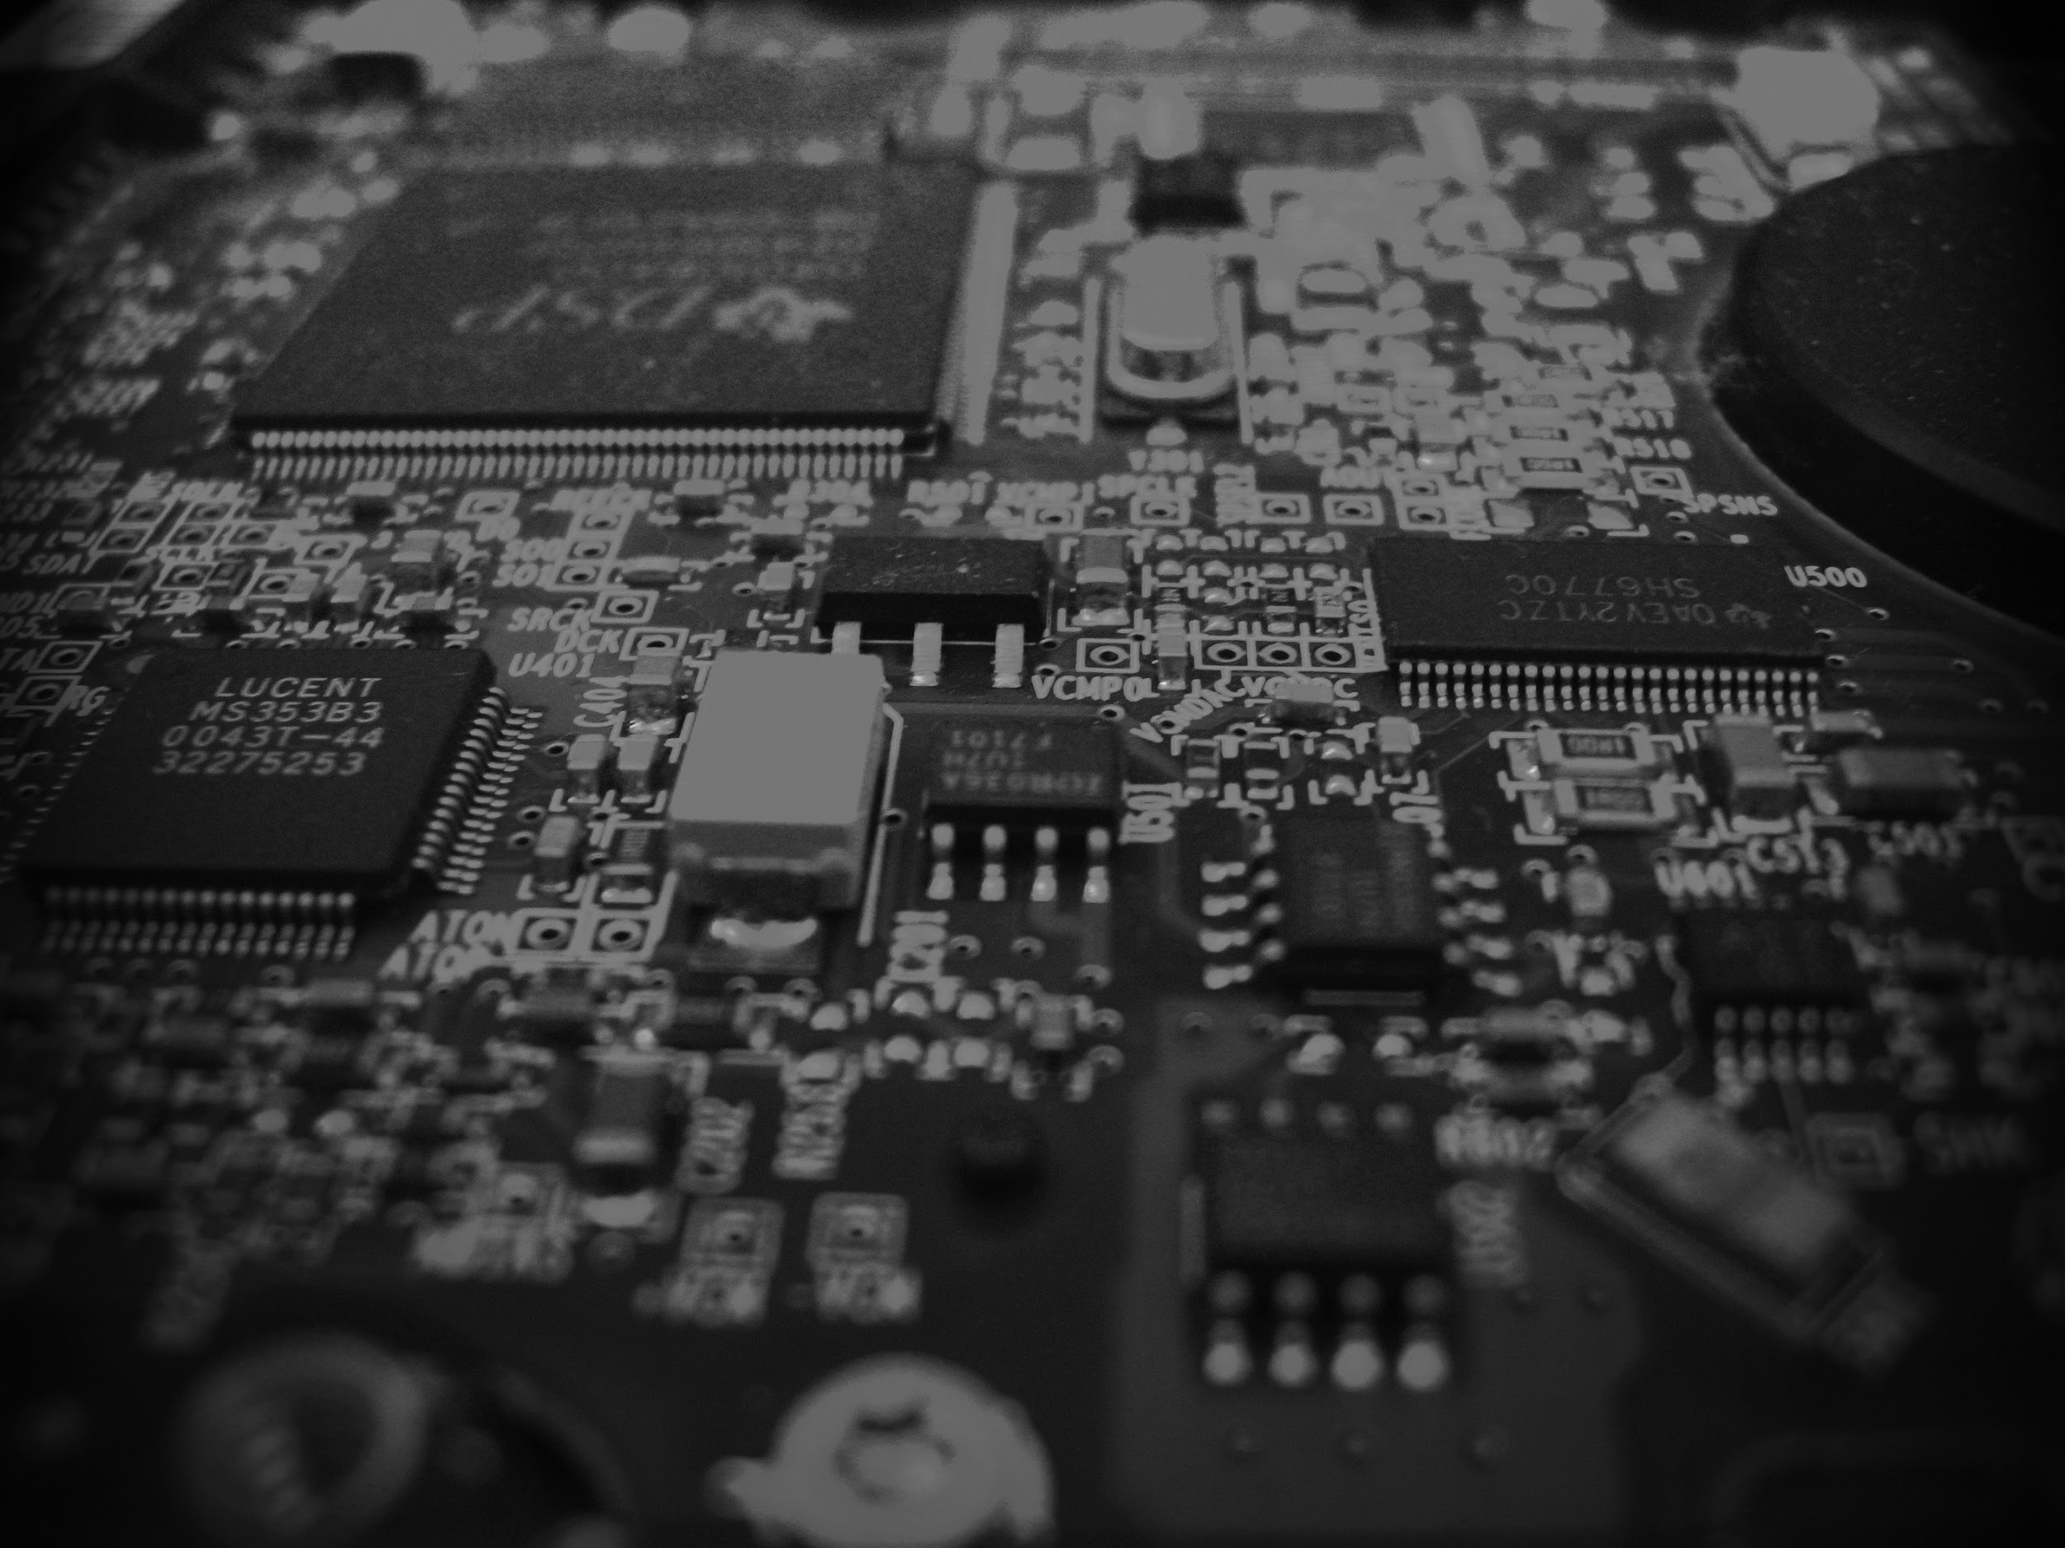
Project Description

Slide 8

Software

Slide 9
Code:
For the code part we took the data from dht, sent to LCD screen and afterwards to the Telegram Bot.
To manage the bot we integrated in the code the library Telegram.bot, writing the id and the name of the bot, we decided to set up the chat_id so that the window notifications arrive only to the memorized users.

Slide 10
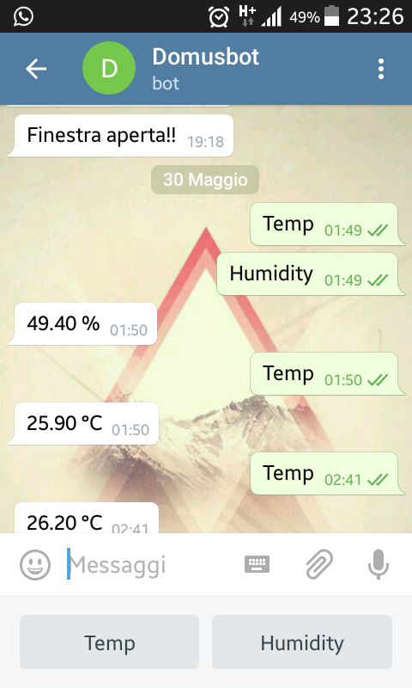
Bot

Slide 11
Bot:
The Bot was developed on Telegram with Bot Father.
His functions are two:
Communicate from users request, through two buttons, the temperature and the humidity in the house.
Notify the opening of the window with a message on Telegram Bot.
The bot is connected to the MKR1000 with the implementation of Telegram.bot library for Arduino, that allows to receive the requests, draw up, and send data to the bot.

Slide 12
Hardware

Slide 13
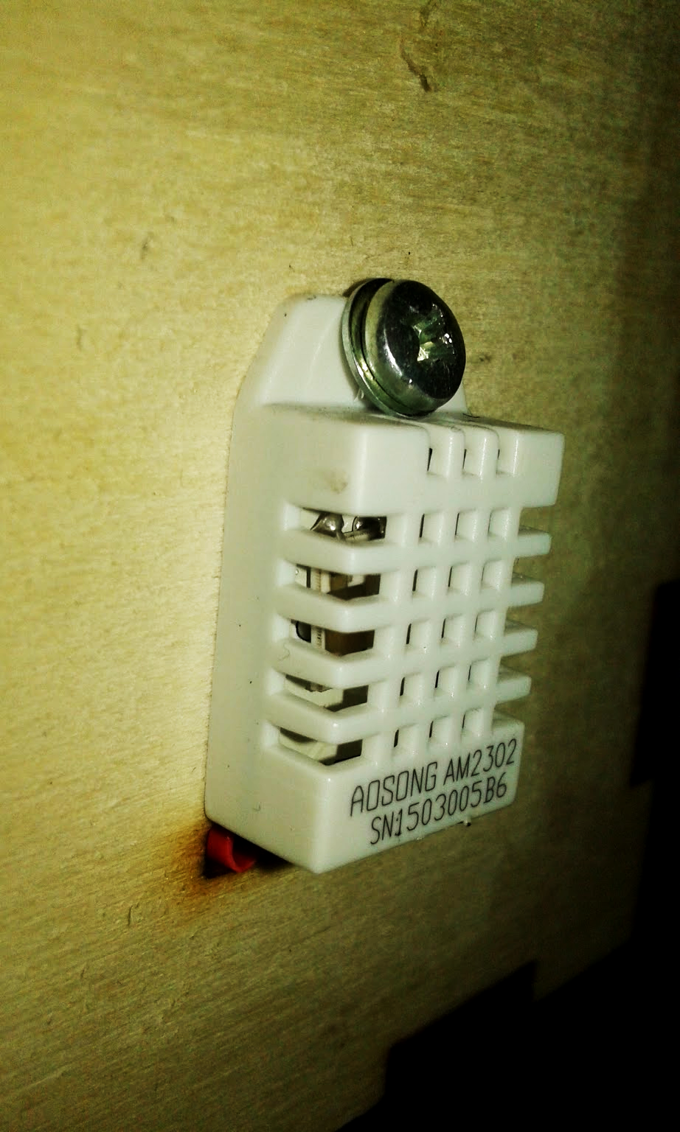
Temperature
&
Humidity

Slide 14
Temperature and Humidity:
For the control of the temperature and the humidity we thought to notify only from the request of the users, through two buttons, to the Telegram Bot.
By using this method you can know at any time the current temperature in your home.

Slide 15
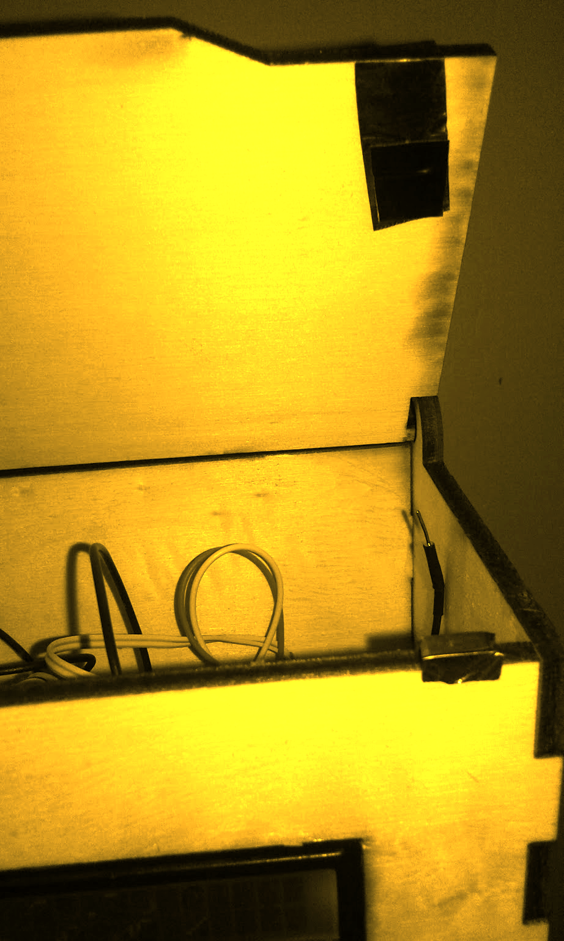
Window:

Slide 16
Window:
We thought to control the opening of the window using a cover on the top of the box, with two cables connected at a tape copper conductor.
In this way you will receive, in the moment where the two tapes are not in contact and they don’t conduct power anymore, a message to the bot that notifies the opening of the window.

Slide 17
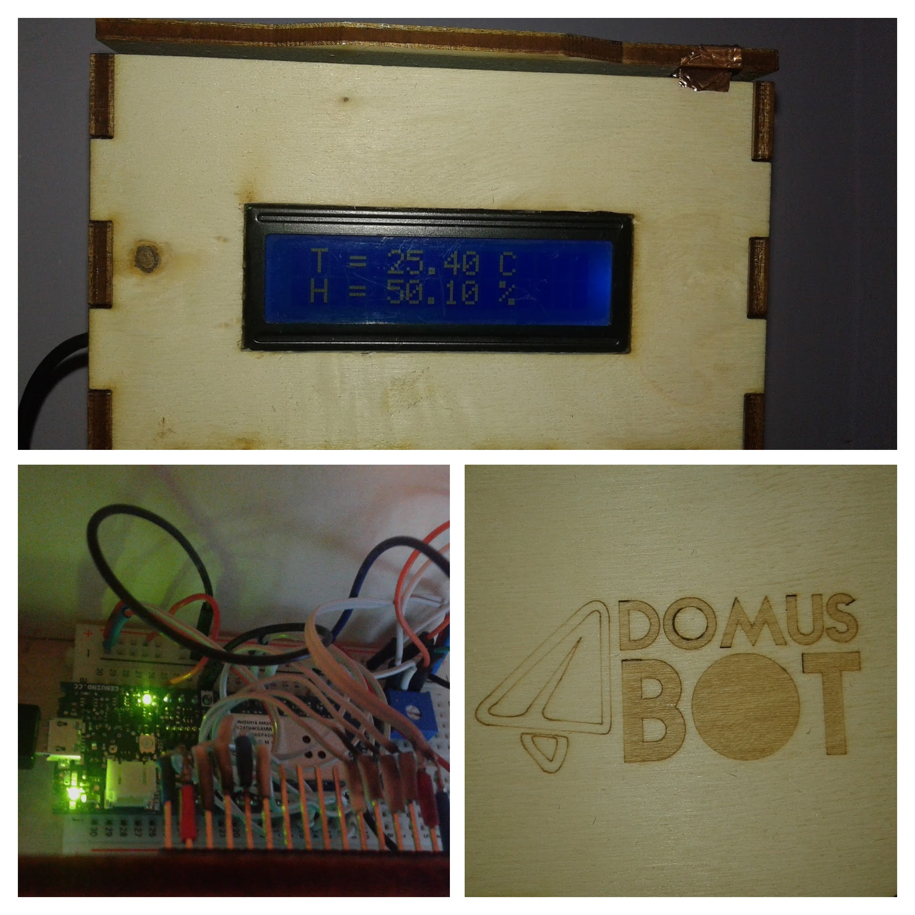
Box

Slide 18
Box:
We conceived and designed a parallelepiped-shaped box, in order to contain a little breadboard and the MKR1000, a small window to see the LCD screen, and a hole on the side to place the sensor, as to receive the best possible values.
We also added a top cover, to simulate the opening of the window.

Slide 19
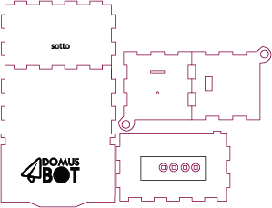

Slide 20
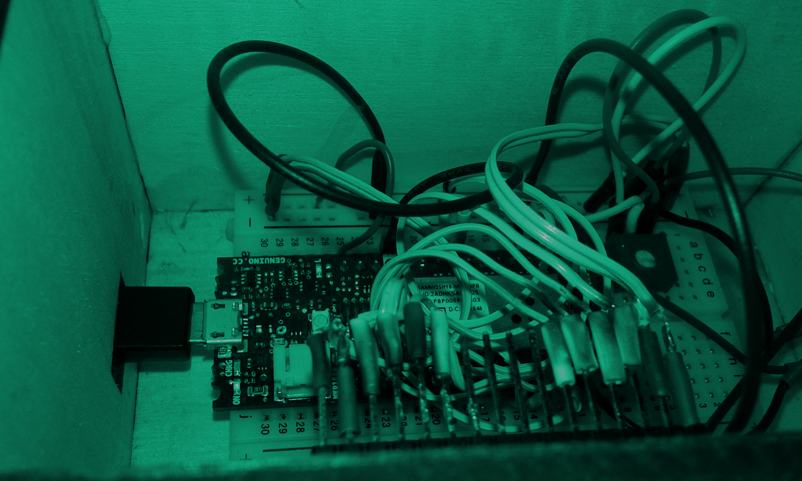
Fritzing & Electronics

Slide 21
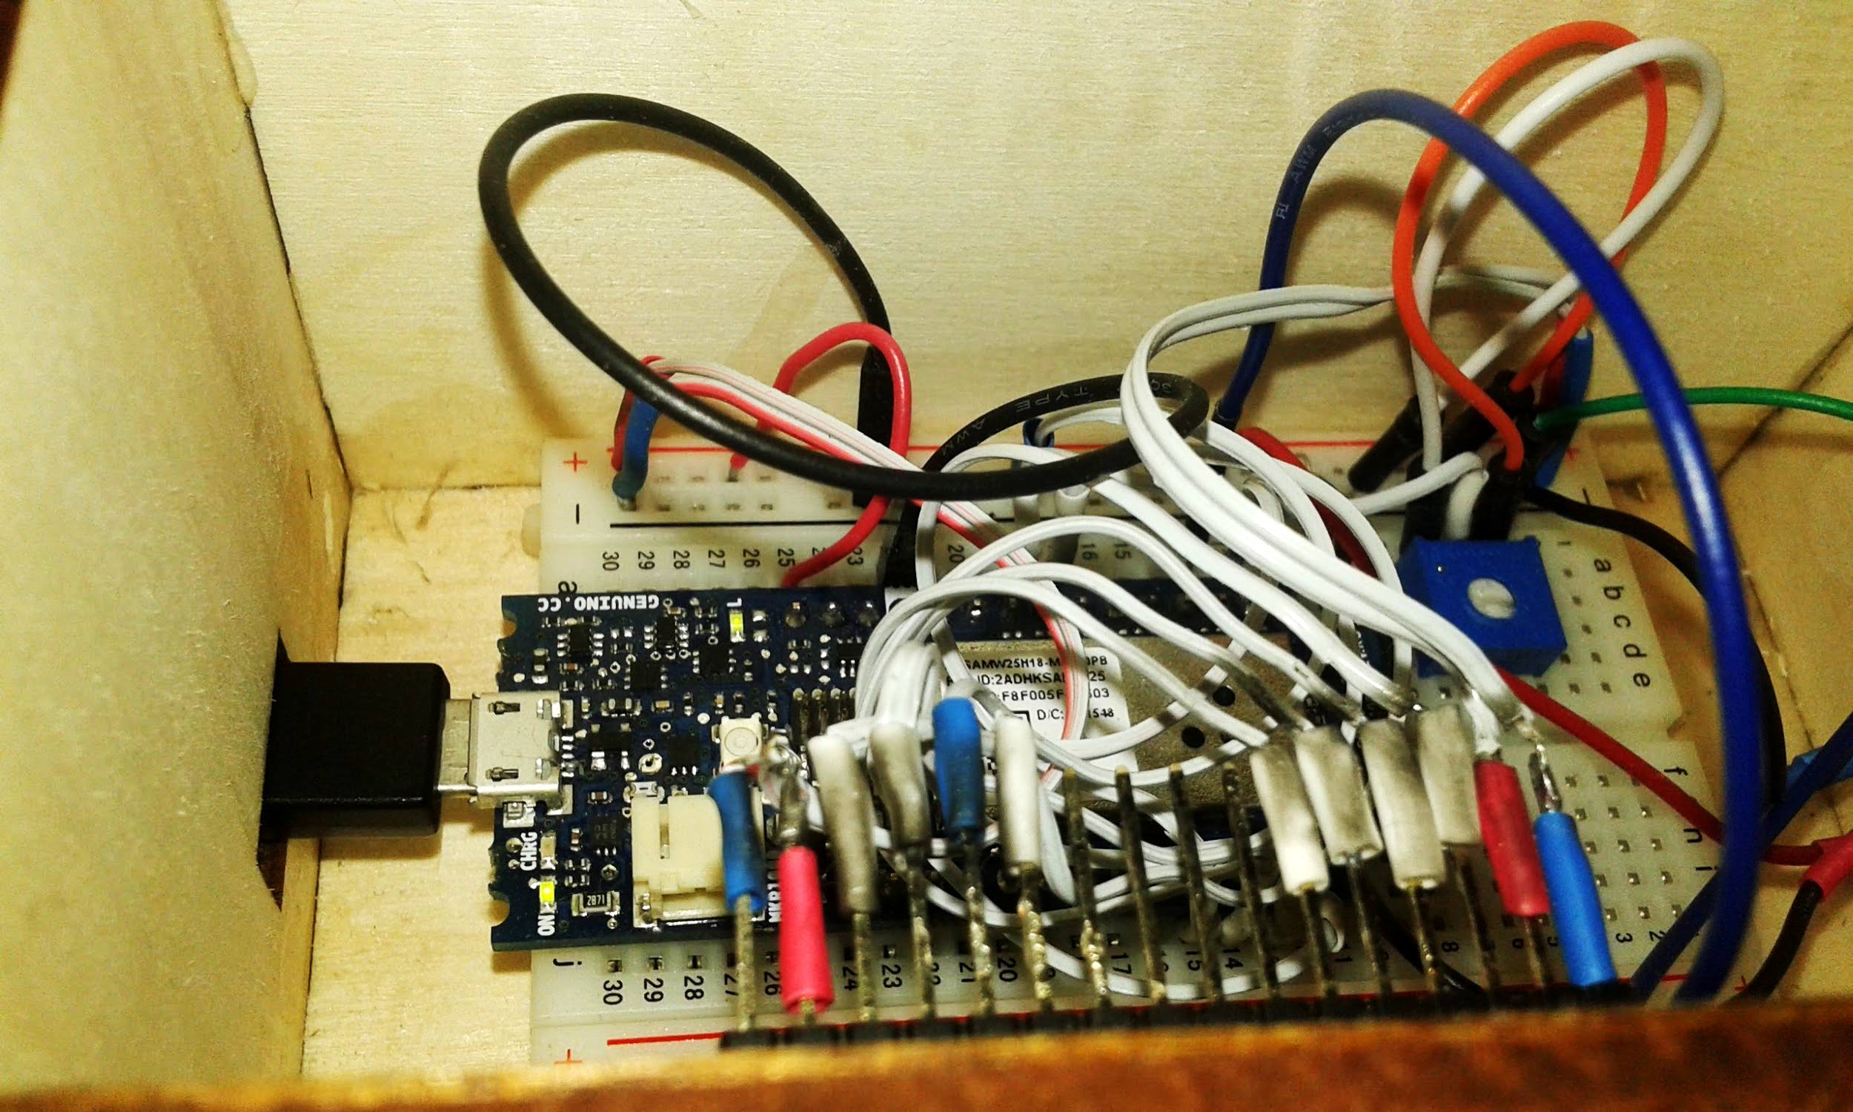

Slide 22
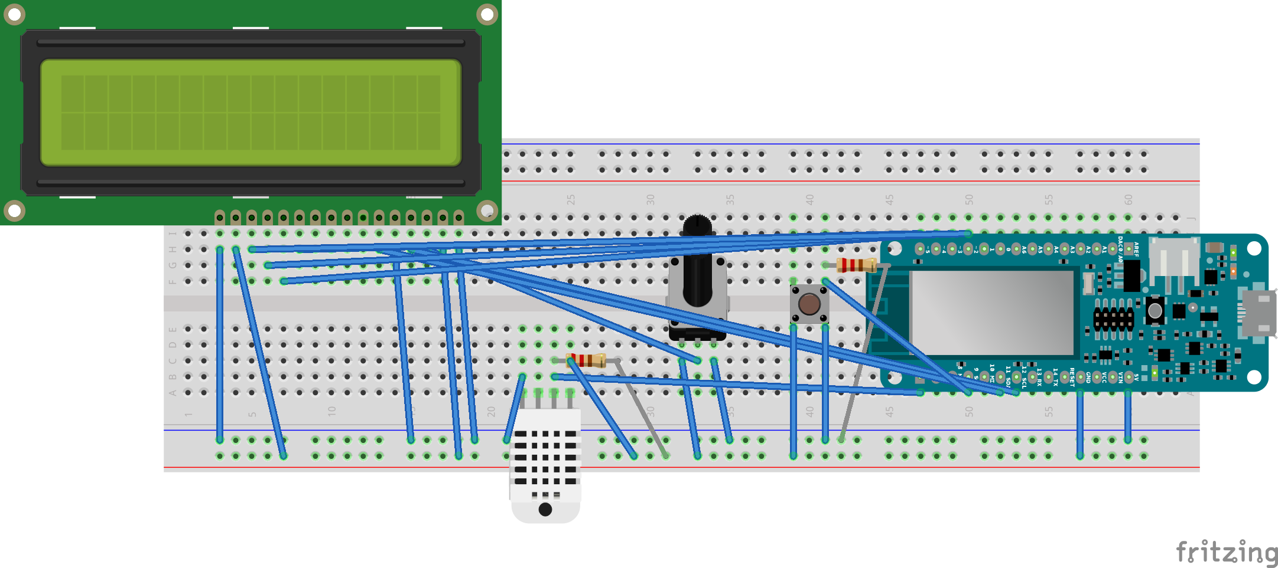

Slide 23
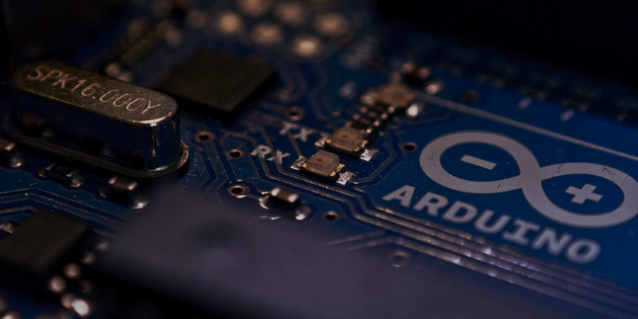
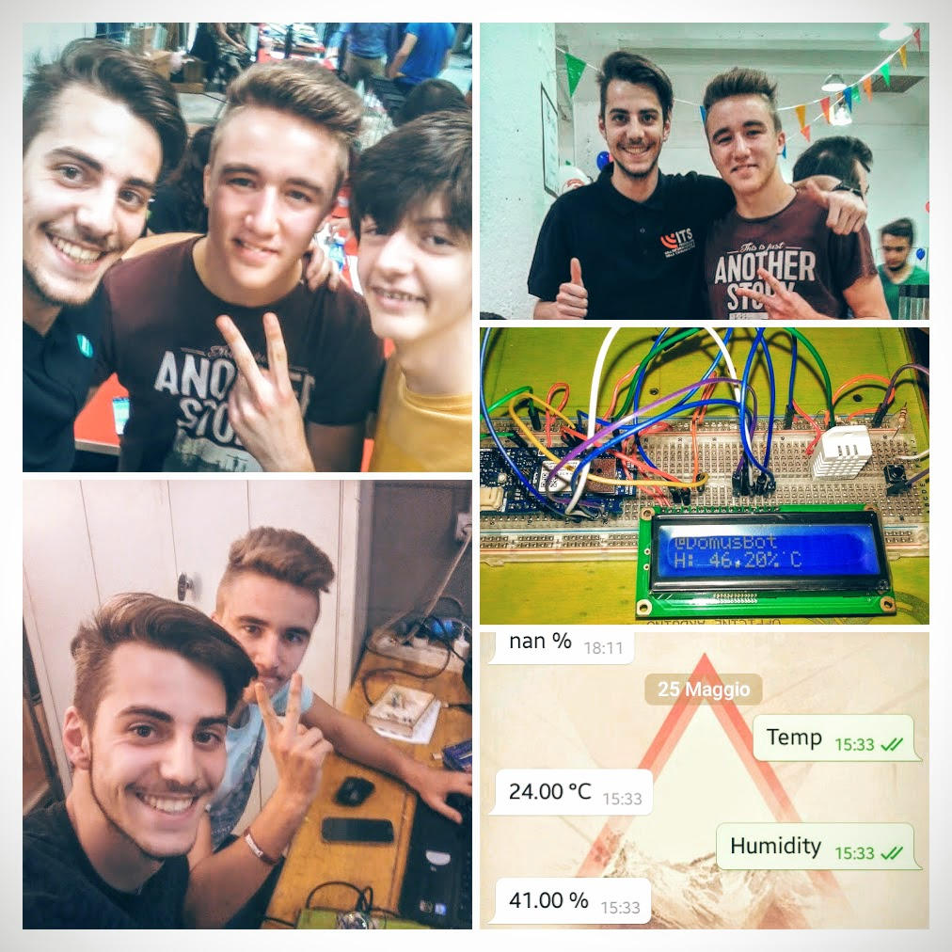
We are:
Luca Paschetta, Marco Delmastro,
Christian Nkomp Temangou, Alessandro Zeppegno e Daniele Lo Rillo.

